Slide 1
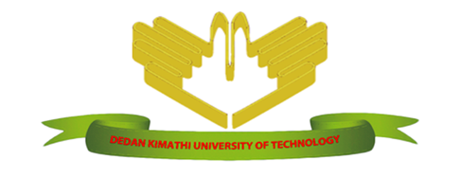
DEDAN KIMATHI UNIVERSITY OF TECHNOLOGY PROJECT TITLE: SMART-IRRIGATION SCHEME SYSTEM BY: KIPROTICH SETT CALEB C025-01-1002/2017
SUPERVISOR: MRS. KURIA JANE

Slide 2
Abstract
Agriculture plays a vital role in both rural and urban economy
Agricultural activities have primarily on rain as a source of water to their crops ; this rain has attested to be insufficient and lacks predictability thus provoking farmers to opt for irrigation.
Farmers have faced water utilization constraints, inappropriate use of electricity , low crop production and tedious work load on them.
The system is obliged to use a GSM technology tool, a Direct-Current motor, soil moisture and water level sensor and a microcontroller to monitor the soil moisture content and the water level in the irrigation reservoirs.
Here, methods of gathering requirements and the development methodology is very vital.

Slide 3
Brief Background
Agriculture is the key to Kenya's economy, contributing 26 per cent of the Gross Domestic Product (GDP).
Farmers, who are used to rain-fed farming systems, are being pushed into dryer, more marginal areas where they become increasingly vulnerable to drought and the unpredictability of weather patterns resulting from climate change.
There is a factor of Global warming ,where one of its side effect is soil dryness giving the urge for irrigation.
Sometimes, people tend to water the plants more than they require. Too little water as well as too much water will be harmful for the plants

Slide 4
Purpose of the Project
This study aims at discovering and developing a smart automated irrigation system that will work to control the amount of water used in irrigation by monitoring the soil moisture content and ensure correct irrigation schedule/time in order to enhance efficiency and effectiveness in agriculture activities.

Slide 5
Problem Statement
We all depend largely on agriculture. There are most common challenges that farmers encounter in irrigation.
In this research there are concerned factors such as the use of electricity appropriately as well as water supply and a suitable schedule or time for irrigating crops.
Farmers have found it difficult to meet these standards, more importantly where poverty is prevalent. Farmers have experienced budget constraints where the bills go beyond their friendly estimated values due to uncontrolled irrigation, excessive usage of electricity and the wages or salaries that can be paid to laborers who might have offered their time and energy to do irrigation. All these features make these research sustainable options to be considered to improve the agricultural activities and irrigation efficiency and effectiveness.

Slide 6
Objectives
Main Objective
The main objective of this project is to develop smart automated irrigation system that will work to ensure effectiveness, efficiency and smoothness in irrigation and agriculture.
Specific objectives:
By the end of this project the system should be able to:
Sense the Soil Moisture Content.
Start to irrigate plants when soil moisture content is below the agricultural value.
Stop irrigating plants when the soil moisture content is above the agricultural value
Show the percentage value of the moisture content, Pump status and time on the screen and allow farmer to manually turn on and off pump on.
Allow the farmer to Turn the system on and off through SMS via GSM module.

Slide 7
Case Studies
Solar-Powered Irrigation System
Drip-Irrigation System
Automatic-irrigation using Solenoid Valves
Automatic Sprinkler irrigation system

Slide 8
Methodology
Agile methodology is favorable for this project.
Agile development model will be appropriate for development of this projects due to its interactive and iterative nature. Development will be based on stages and with the use of the model, I will always come back to a stage I already finished up if there occurs a change in the requirements i.e. iterative aspect.
The flexible nature of agile methods is the motivating factor to its usage

Slide 9
System Analysis & Design
Introduction.
This chapter entails how the system is analyzed and designed
Feasibility analysis is discussed and it deals with the practical system to be implemented.
In the design, the system is made easier for the user to promote friendly interaction during navigation.

Slide 10
Feasibility Analysis
Technical Feasibility- can the system be built? The technical risk.
Economic Feasibility- Should we Build the system? Costs and benefits
Scheduling Feasibility- Can the System be able to be completed on time? The question of availability of system requirements
Operational Feasibility-how well will the customers needs will be met by completing the project?

Slide 11
Requirement Analysis
Functional Requirements
These are functionalities or operations that the system must perform. In this system the following will be functionalities in the user section. For this case, the user is the farmer
Farmer inserts soil moisture sensor to the soil.
Farmer checks the soil moisture level in the soil.
Farmer chooses to manually turn on water pumps.
Non-Functional Requirements
Speed -Be fast in terms of response time.
Ease of use- Be learnable and easy to use for all type of users.
Reliability- Minimum meantime to failure, low probability of unavailability and rate of failure occurrence. It should be available at all times.

Slide 12
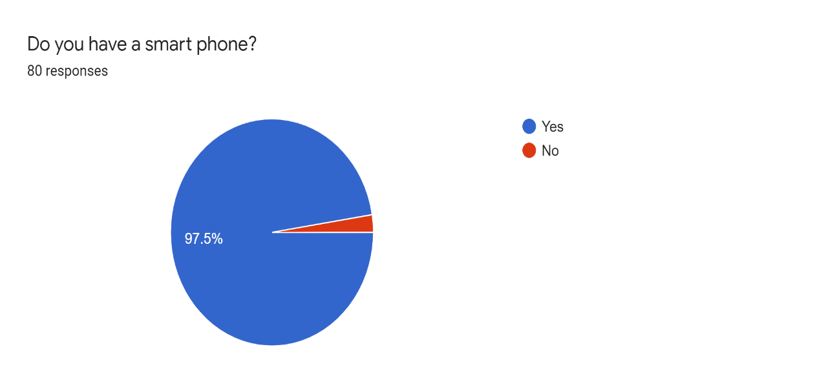

Data Analysis

Slide 13

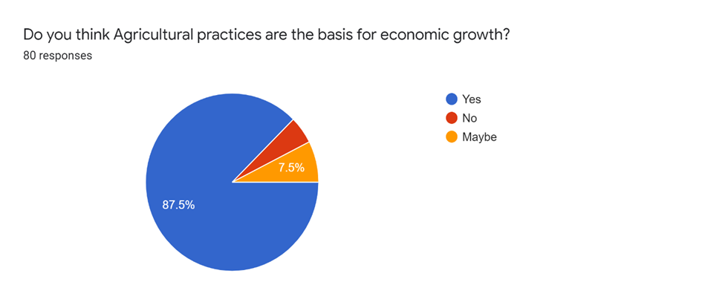

Slide 15
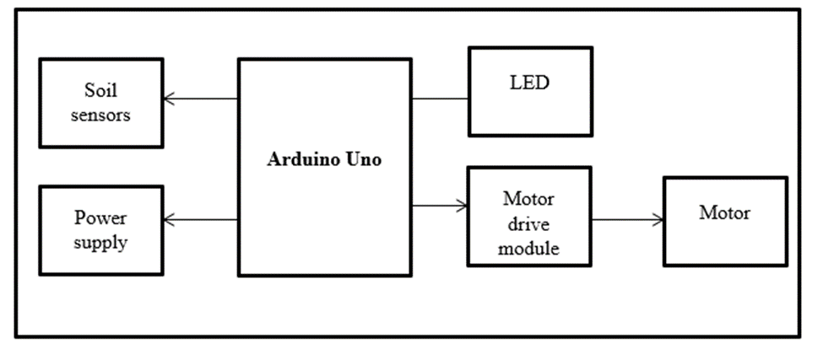
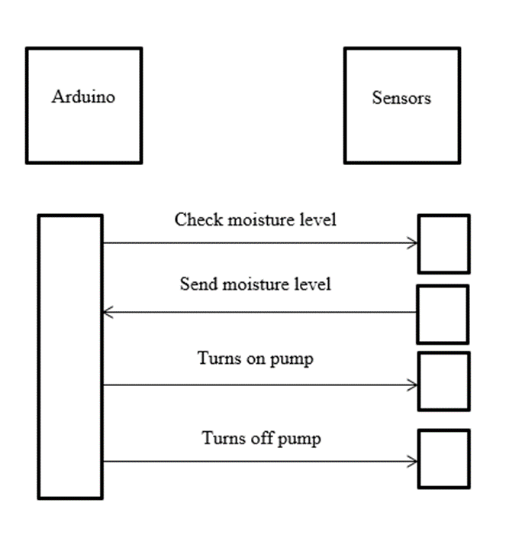

Slide 16
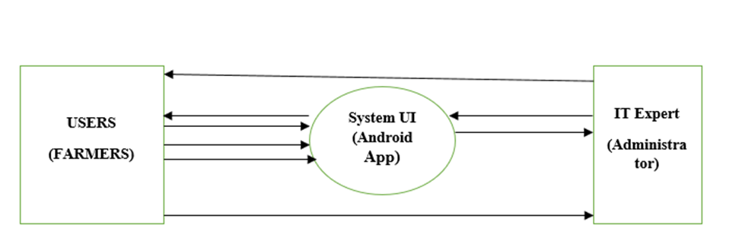
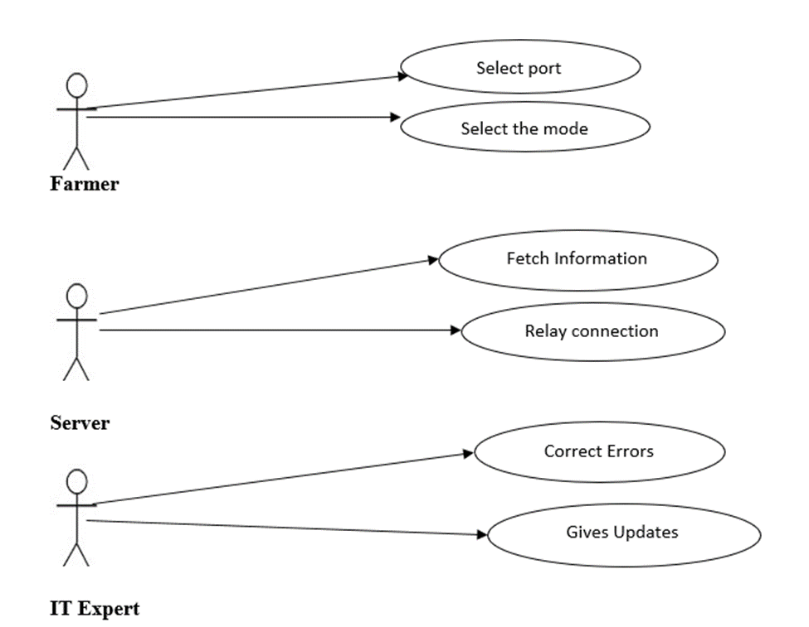

Slide 17
SYSTEM IMPLEMENTATION AND TESTING
Test Plan
Test Plan in software and system testing is the document that outlines the who, what, when, and how to do a testing of a project.
Unit Testing: Involves examining the minimal software components and subcomponents or modules such as the turning on and off water pumps, reading soil moisture among other modules.
Integration Testing: Different modules of the system were combined together and tested as a whole. In this process, it verified that the individual components integrated were able to work together and interact well without any conflicts. It was tested that the integrated modules were able to meet the stated user needs.
Acceptance Testing: activities involved taking the final system to the real users of the system to test the system for themselves. After the testing it was found that the system had good usability and could be easily understood even by people with little computing knowledge.

Slide 18
Test Cases
A test case is a set of conditions or variables under which a tester will determine whether a system under test satisfies requirements or works correctly. This is a process which involved a series of different kinds of tests performed on the system and its components. The process of developing test cases can also help find problems in the requirements.
Automatic Page
This is the automatic page of the application interface which shows the time of the day, date, pump status and the percentage of the moisture content.
The initial percentage should be zero as shown below:

Slide 19
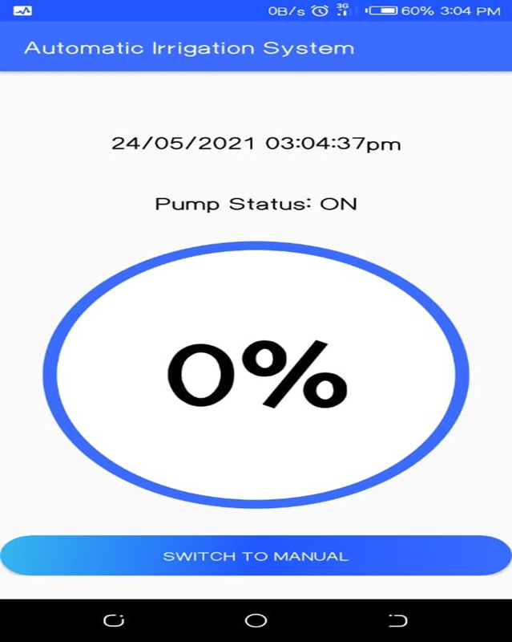

Slide 20
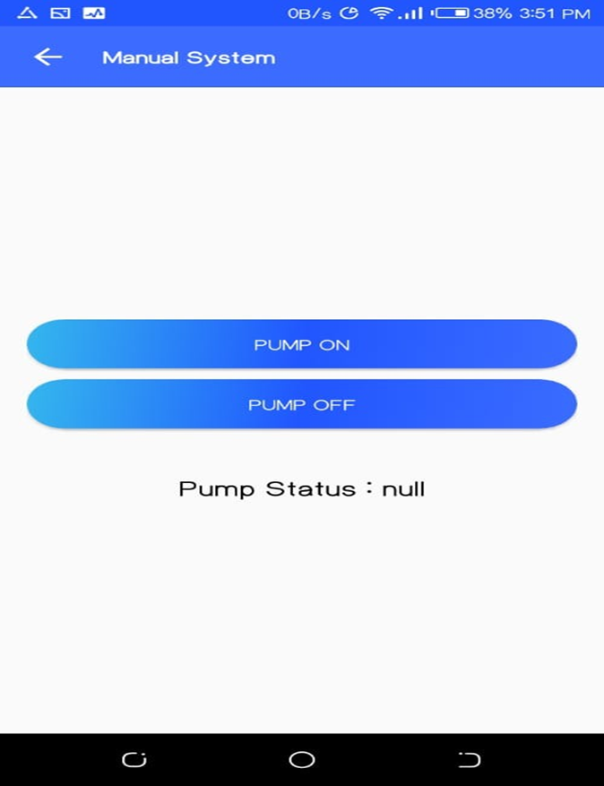
Manual Page

Slide 21
Implementation Strategy
Having the requirements being quite clear. I started on the implementation of the findings. It is in this stage that I did acquire and developed the programs that will help meet the expectations of the system. Moreover, I developed interfaces that will enable farmers interact with their irrigation process as show in the test case diagrams above.

Slide 22
References
Understanding the Agile Software Development Lifecycle and Process Workflow. (2019). Retrieved from https://www.smartsheet.com/understanding-agile-software-developmentlifecycle-and-process-workflow
Data Collection Methods - Research-Methodology. (2019). Retrieved from https://researchmethodology.net/research-methods/data-collection/
Moller, J. (2010). A Versatile Technology in automation of agriculture machinery. Computer vision, 17.
Drip and Micro Irrigation Design and Management for Trees, Vines, and Field Crops, 5th Edition, by Charles M. Burt and Stuart W. Styles, published by the Irrigation-Training and Research-Center (ITRC), Cal Poly, San Luis Obispo, CA 93407–0721. www.itrc.org , (2016)
Irrigation, 5th Edition, Muhammad Irfan Khan Yousafzai, Claude H. Pair, editor, published by the Irrigation Association, (1983)
A solution to water management in agriculture- By Stéphanie Roblin (2016). Retrieved from http://www.renewableenergyfocus.com/view/44586/solar-powered-irrigation-a-solution-towater-management-in-agriculture/
Vagulabranan, R., Karthikeyan, M., & Sasikala, V. (2016). Automatic Irrigation System on Sensing Soil Moisture Content. International Research Journal of Engineering and Technology (IRJET), 3.
Scribd. (2017). Automatic Irrigation System on Sensing Soil Moisture Content | Irrigation | Soil. [online] Available at: https://www.scribd.com/document/362464538/Automatic-IrrigationSystem-onSensing-Soil-Moisture-Content.
Moller, J. (2010). A Versatile Technology in automation of agriculture machinery. Computer virsion, 17.

Slide 23
END THANK YOU

